Slide 1
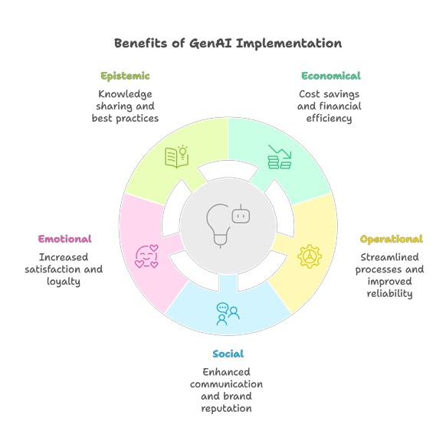
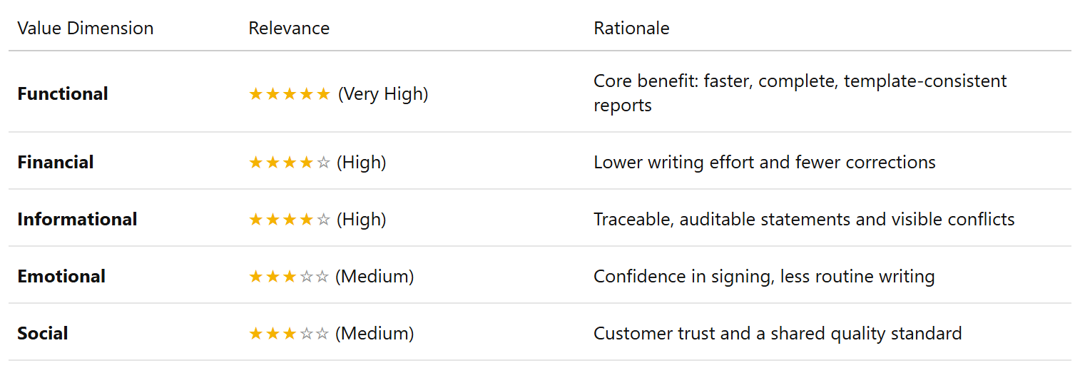
Value evaluation model: Report writing use case
BETA version
⚙️ Functional Value (Primary)
⏱️ Faster report writing
🧩 Less manual merging of sources
📋 Consistent template structure
✅ No required item silently left out
Outcome: More reports completed per inspector, with fewer revision rounds
💰 Financial Value
📉 Lower writing effort per report
🛠️ Fewer corrections after delivery
📈 Higher report throughput
Outcome: Lower cost per report
📊 Informational Value
🔗 Every statement traceable to a source
⚖️ Conflicts between sources made visible
📚 Reusable section-bound knowledge
Outcome: Reports that can be checked, audited and reused
❤️ Emotional Value
🛡️ Confidence in signing the report
🖐️ Less routine writing
🤝 Trust in the draft
Outcome: Inspectors spend their time on inspection and judgement
🌱 Social Value
🏠 Clear, consistent reports for customers
🔍 Transparent basis for property decisions
👥 Shared quality standard across inspectors
Outcome: Stronger customer trust in the report
Informational

